Slide 1
GMHS Support Tool
Sowmya & Abhishek

Slide 2
Why GMHS Support Tool ?
The main aim for this tool is to prevent the new incidents and solve the issues before users identified them.
Also minimizing the direct sql server interaction for the smaller task as well

Slide 3
Technology used
Angular
Web API
SQL Server

Slide 4
Identified Areas …
Package
Inspection
Loose Part Orders
Production Orders
Transports
Checks for old unused data
Small DB insertion(Printer, Cost centers, Controllers etc.)

Slide 5
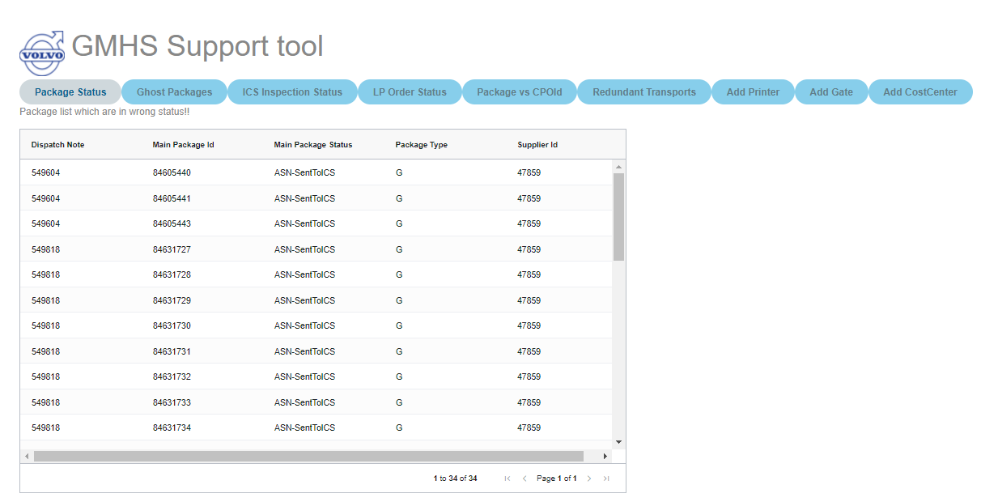
Packages… Sometimes due to wrong way of working or missing data, packages got stuck with status SentToICS.

Slide 6
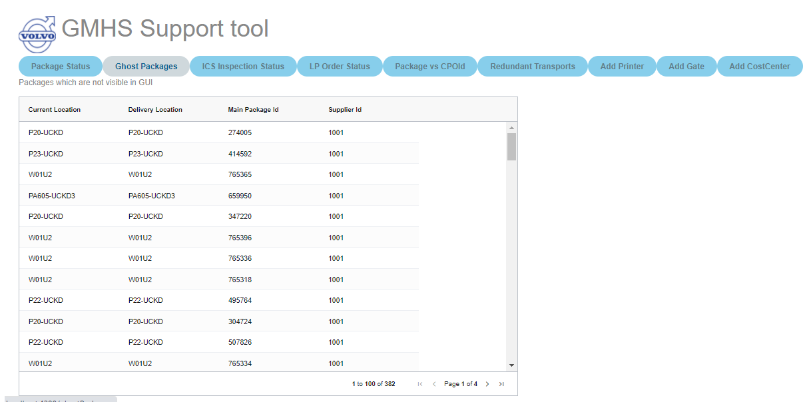
Packages… Package which are not having any sub packages due to that they are not visible in GUI called show packages and hence they can be removed, and location can be utilized or removed.

Slide 7
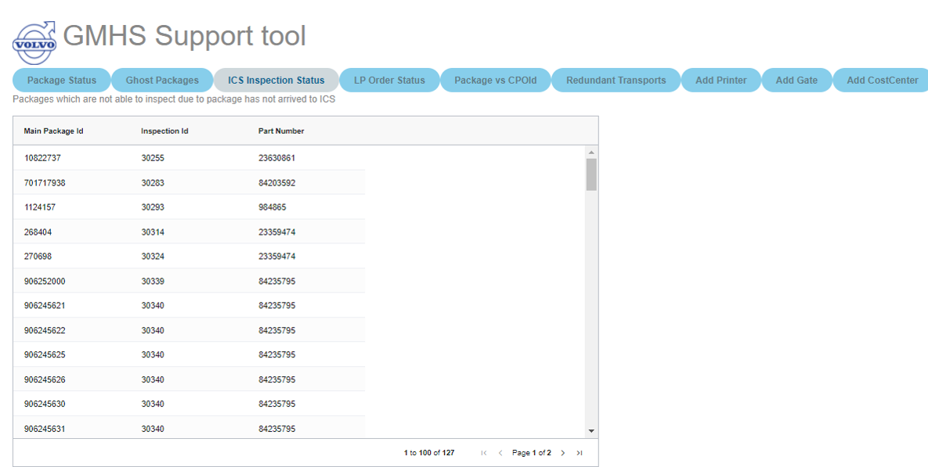
Packages… Sometimes packages got blocked with ISP(Inspection block code). Hence, user can not work those packages. Issue users can’t perform the inspection since package are not at inspection location or could be other reason too.

Slide 8
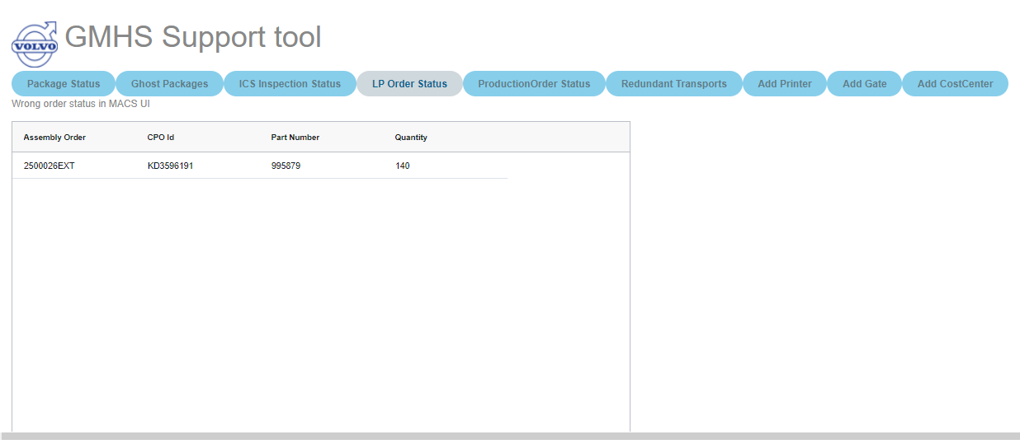
LP order status … Due to manual handling or user requests sometime the order status did not match with order lines status that leads confusion for the users.

Slide 9
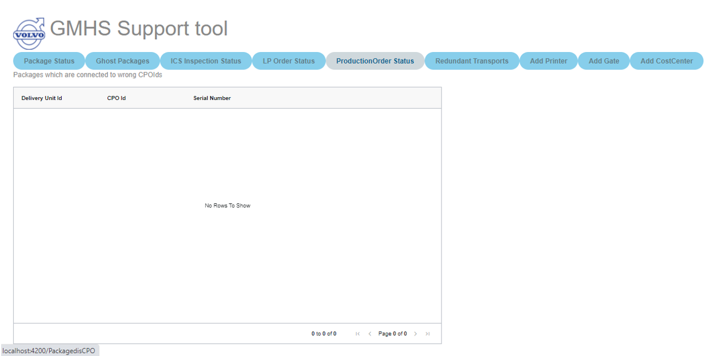
Production Orders /DUs Due to late change of Customer/Receiver/Flow or Rebooking the engine, package may have wrong CPOID and that cause issue in dispatch.

Slide 10
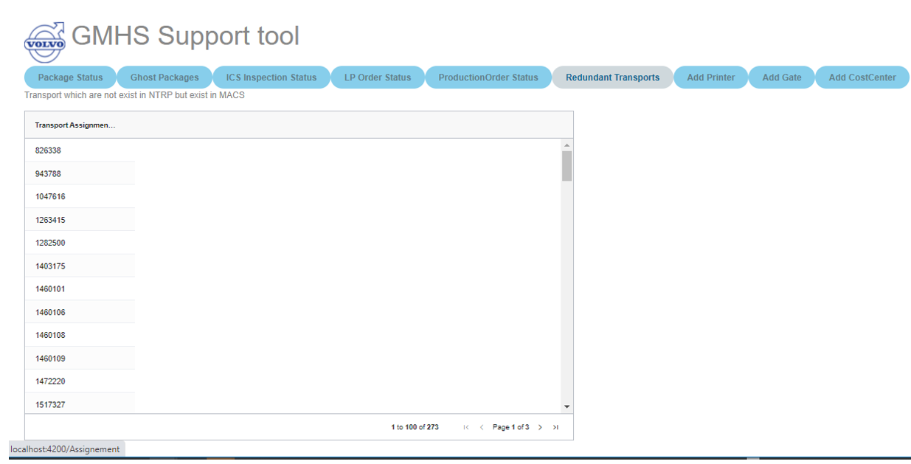
Redundant Transports MACS could have some transports which are completed in NTRP but due to some reason they failed in MACS. Hence, they needs to be handled so that user can work with those packages. So, it’s good to have a look on them before user found the such transports.

Slide 11
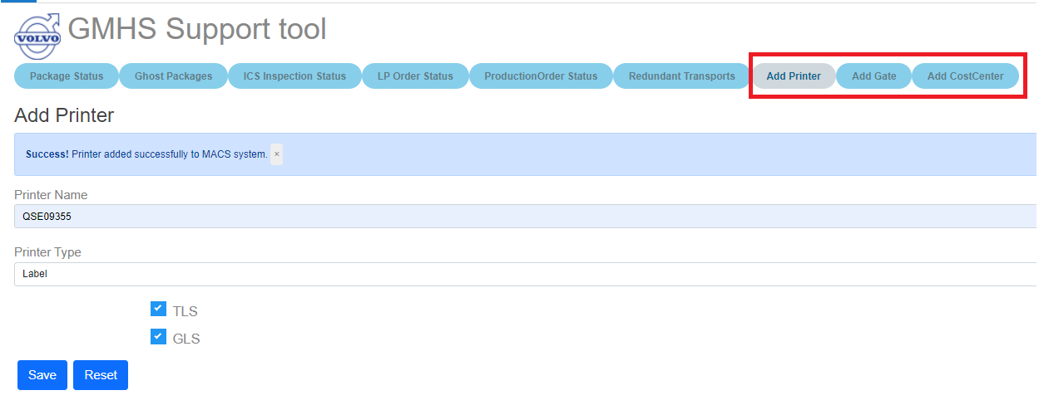
Insert operations (Printer, Cost Center, Gate, Controller etc..) GUI for small insert operations.

Slide 12
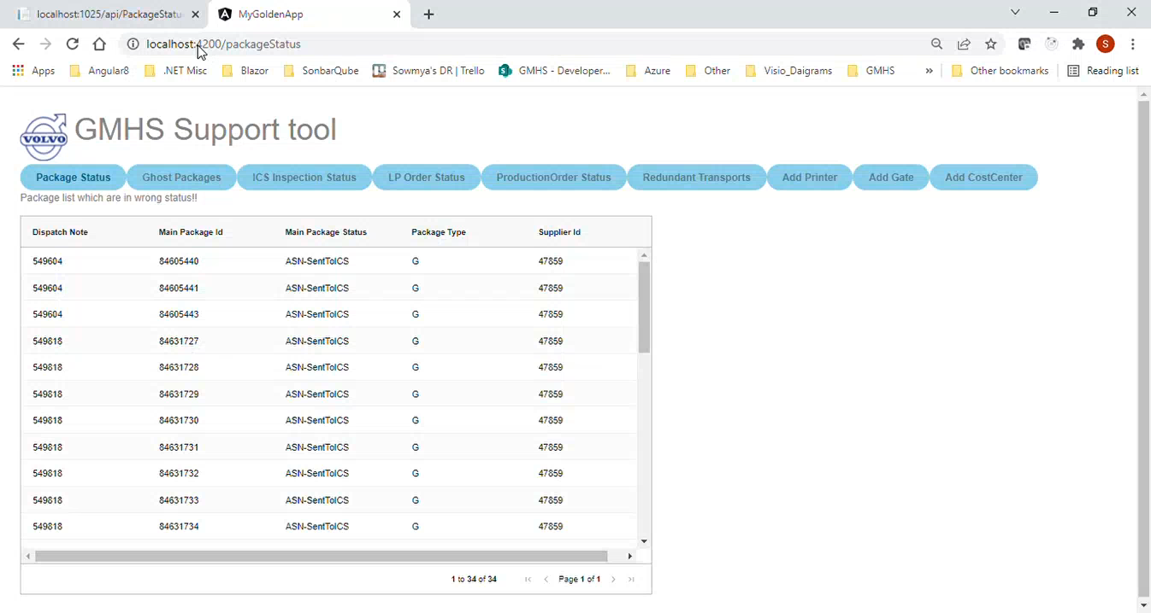
Demo Video:

Slide 13
Thank You

